Slide 1
Domestic Violence and Child Contact Workshop Monday 14th October 2013

Slide 2
N. Ireland Policy Context
Tackling Violence at Home Strategy 2005
Domestic and Sexual Violence Action Plan 2012-2013
Domestic and Sexual Violence Strategy (Draft)2013- 2020
(Dept. of Justice and DHSSPS)

Slide 3
Local Domestic Violence Partnerships established …….
“To develop and maintain local partnerships for shared understanding and work to tackle Domestic Violence.”

Slide 4
Membership
Barnardo’s
Citizens Advice
N.I. Court/Tribunal Service
Solicitor
Education
Health and Social Services
N.I.Housing Executive
NSPCC
PBNI
PSNI
DPCSP
Social Security Agency
Trade Unions
Victim Support
Voluntary/Community Groups
Women's Aid

Slide 5
Key Themes 4 Working Groups
Support and Prevention
Protection and Justice
Training and Development
MARAC (Multiagency Risk Assessment Conferencing)

Slide 6
Protection and Justice
Child Contact and Domestic Violence
Respond to issues raised by victims and staff.
Clarify the legal process -Pre proceedings and Residence /Contact applications
Develop guidance and consider training needs

Slide 7
Purpose of the workshop
A Pilot workshop with experienced staff from a range of agencies
Draft Guidance – sign off
Does it work? What needs changed or amended?
Share with wider audience/staff groups?

Slide 8
Emma’s Story ……..

Slide 9
Introducing the Guidance
Karen McCall
Principal Officer
Children's Social Services
Belfast HSC Trust

Slide 10
Child Contact….the debate
“It’s been like going through the abuse again, it really has. So that abuse that I suffered in my marriage, that walking around on eggshells, it’s been the same thing”.
Mother “Picking Up the Pieces”

Slide 11
“They [perpetrators] take unreasonable stances on contact, make extra applications to increase the number of hearings and face-to-face encounters, but don't actually properly apply themselves to such contact as they may get.”
Barrister “Picking Up the Pieces”

Slide 12
“It is, in my view, high time that the Justice System abandoned any reliance on the
proposition that a man can have a
history of violence to the mother of his
children but, nonetheless, be a good father”
Lord Justice Wall, 2006

Slide 13
“Don’t assume you know ‘what is good for me’ without asking me. Don’t assume you ‘know me’ without getting to know me.
And for God’s sake if I manage to tell you what’s wrong with me, please listen to what I have to say, don’t interpret it, just listen”.
Young person, Contact study, 2009.S.Holt

Slide 14
Child Contact Guidance
Aims
To enable staff to support victims in a timely and appropriate manner through the pre proceedings/ court process.
To support and encourage victims to highlight all relevant information to solicitors immediately upon receipt of a request from a perpetrator (or their solicitor) and /or at the commencement of proceedings in the family proceedings court.

Slide 15
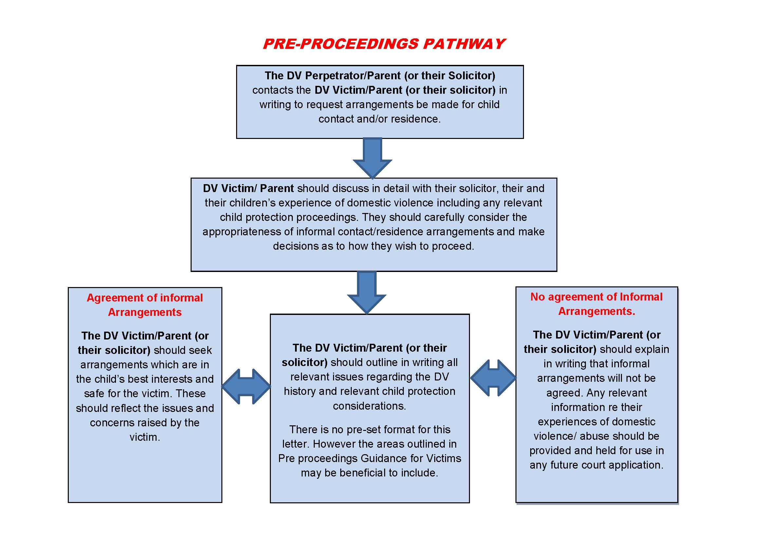

Slide 16
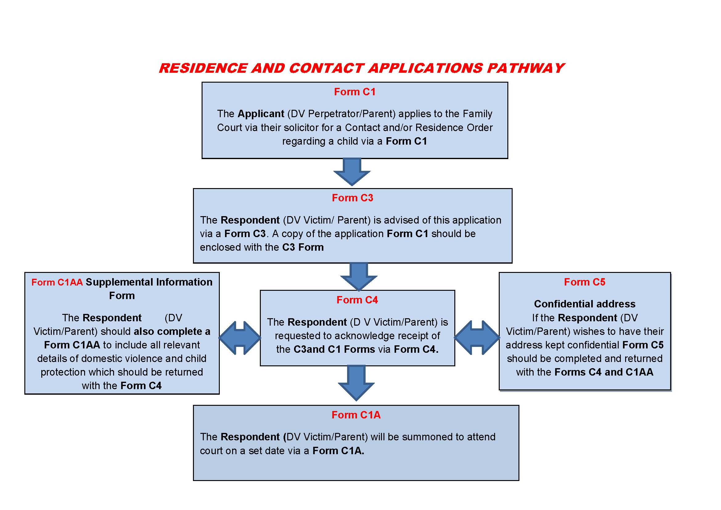

Slide 17
If it was easy everybody would be doing it……..

Slide 18
Coffee

Slide 19
COURT CHILDREN’S SERVICE
KERRYLEE WEATHERALL
BELFAST HEALTH & SOCIAL CARE TRUST

Slide 20
AIM
Setting the Scene
Regional Court Children’s Service Model
Role and Remit of CCO
Case Examples
Challenges & Development

Slide 21
Setting the Scene
Introducing CCS
Women’s aid Partnership : putting contact on the agenda
CCO’s practice experience : need for earlier intervention/support re DV
Safe & meaningful contact assessments / children’s best interests

Slide 22
Regional Court Children’s Service N.Ireland
CCS Established in 2008, endorsed by Courts and HSC Trusts re: equality of service delivery
Standardised methods of working
Improving services for children and their families
Child’s voice being heard

Slide 23
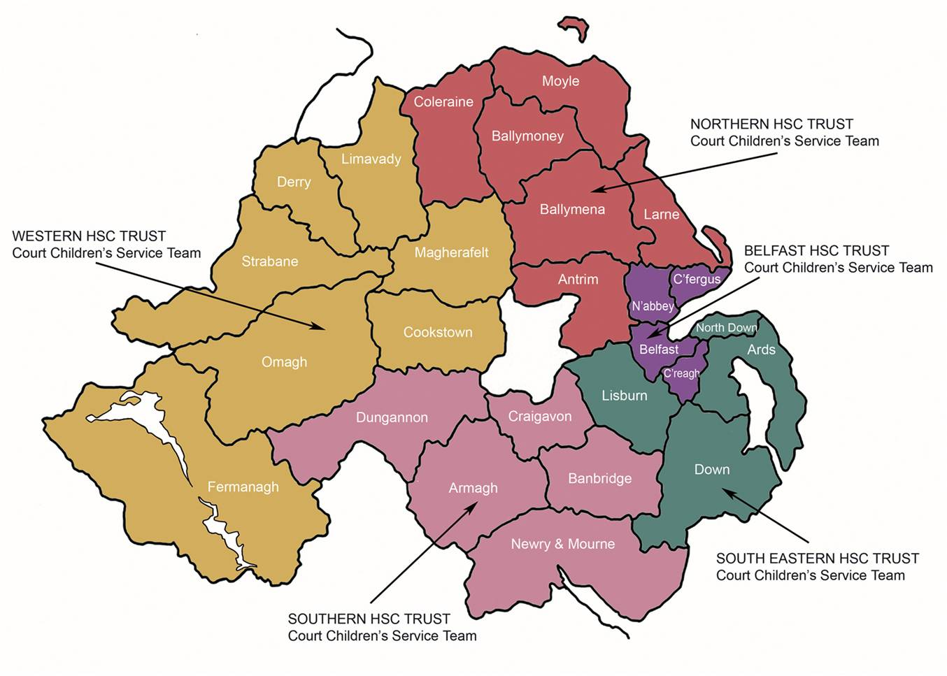
Regional Court Children’s Service

Slide 24
Location Of Courts Across N.Ireland In HSC Trusts Areas

Slide 25
Referral to the CCS
Initial stages/ mid way/ towards the end of Court proceedings
Judge authorises whether a referral should be made to CCS
Solicitors complete referral form with attached C1, SAE and any other applicable information

Slide 26
Role and Remit of CCO
Mediate with Parents/Significant others
Direct work with children
Multi-professional Liaison
Observing/ assessing contact
Home Inspections
Access supportive services
Assess and Represent the Child(ren) best interests : Welfare checklist; make recommendations to the Court

Slide 27
Types of DV Case examples
1 Parent victim of DV
DV Lifestyle of both parents, underestimating impact on children
DV counter-allegations : context
DV at handover
Re-partnering with a DV perpetrator
1 child agreeing and their sibling not to contact

Slide 28
Challenges & Developments
Unravelling complexities
Couples agreeing outside of court
Personal/Self litigants
Language barriers : Using Interpreters
Accessing Services
Guide to Case Management
Family support hubs
Developing CCS to meet needs

Slide 29
Key Messages
When you have a complicated story, it helps if there is someone around to help you with the narrative, so you can put the chapters together.....

Slide 30
Key Messages
“ Not being heard, not being allowed to participate in decisions about them … is the single most important issue to children in N.Ireland” (p22).
(Davey, C et al (2004) ‘Children’s Rights in N.Ireland’,NICCY.)

Slide 31
The Legal Processes and Challenges
Anne Caldwell, Solicitor
Flynn & Mc Gettrick

Slide 32
Feedback/ Discussion
1.Will the guidance support staff in practice?
2. Any additions/ omissions?
3. Are there limitations ?
4. Comments / Recommendations

